Slide 1
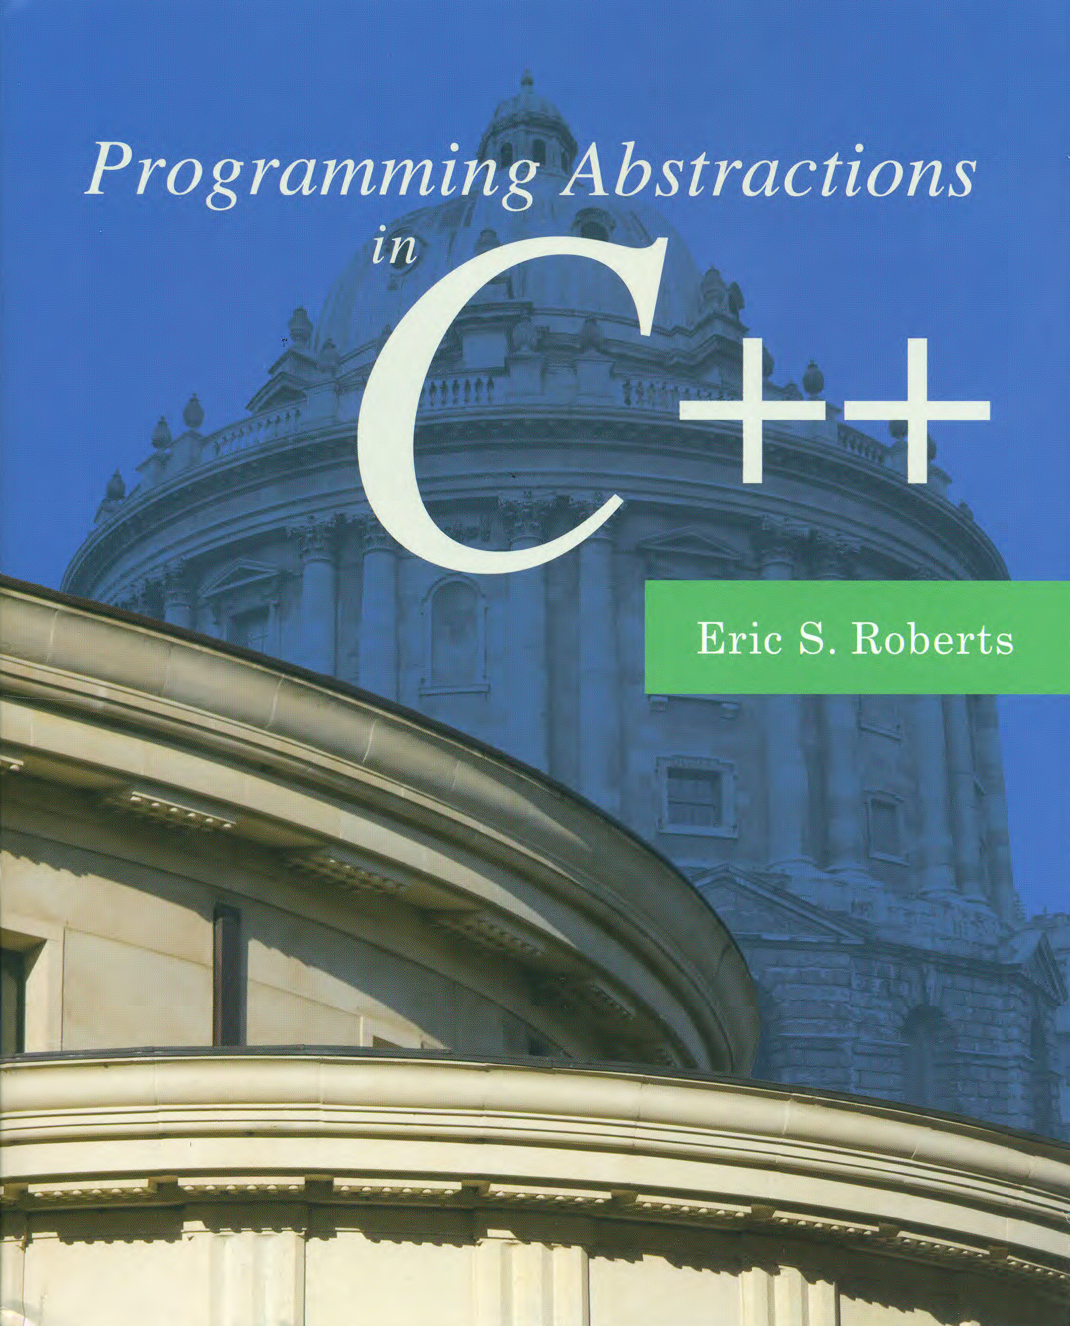
Collections
C H A P T E R 5
In this way I have made quite a valuable collection.
—Mark Twain, A Tramp Abroad, 1880
5.1 The Vector class
5.2 The Stack class
5.3 The Queue class
5.4 The Map class
5.5 The Set class
5.6 Iterating over a collection

Slide 2
The Collection Classes
Chapter 5 describes a set of useful library classes that contain other objects and are therefore called container or collection classes.
Vector
Grid
Stack
Queue
Map
Set
Lexicon
Here are some general guidelines for using these classes:
These classes represent abstract data types whose details are hidden.
Each class (except Lexicon) requires type parameters.
Declaring variables of these types always invokes a constructor.
Any memory for these objects is freed when its declaration scope ends.
Assigning one value to another copies the entire structure.
To avoid copying, these structures are usually passed by reference.

Slide 3
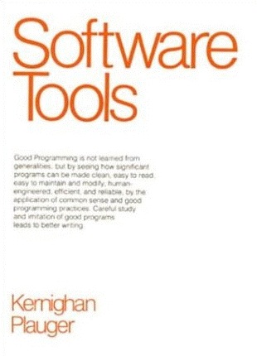
ADTs as Software Tools
Over the relatively short history of software development, one of the clear trends is the increasing power of the tools available to you as a programmer.
One of the best explanations of the importance of tools is the book Software Tools by Brian Kernighan and P. J. Plauger. Even though it was published in 1976, its value and relevance have not diminished over time.
The primary theme of the book is that the best way to extend your reach in programming is to build on the tools of others.

Slide 4
Template Classes
The collection classes are implemented as template classes, which make it possible for an entire family of classes to share the same code.
Instead of using the class name alone, the collection classes require a type parameter that specifies the element type. For example, Vector<int> represents a vector of integers. Similarly, Grid<char> represents a two-dimensional array of characters.
It is possible to nest classes, so that, for example, you could use the following definition to represent a list of chess positions:
Vector< Grid<char> > chessPositions;

Slide 5
Constructors for the Vector<type> Class
Vector<type> vec;
Initializes an empty vector of the specified element type.
Vector<type> vec(n);
Initializes a vector with n elements all set to the default value of the type.
Vector<type> vec(n, value);
Initializes a vector with n elements all set to value.
The Stanford C++ library implementation of Vector includes a shorthand form for initializing an array given a list of values, as illustrated by the following example:
Vector<int> digits;
digits += 0, 1, 2, 3, 4, 5, 6, 7, 8, 9;

Slide 6
Methods in the Vector<type> Class
vec.size()
Returns the number of elements in the vector.
vec.isEmpty()
Returns true if the vector is empty.
vec.get(i) or vec[i]
Returns the i^{th} element of the vector.
vec.set(i, value) or vec[i] = value;
Sets the i^{th} element of the vector to value.
vec.add(value) or vec += value;
Adds a new element to the end of the vector.
vec.insertAt(index, value)
Inserts the value before the specified index position.
vec.removeAt(index)
Removes the element at the specified index.
vec.clear()
Removes all elements from the vector.

Slide 7
The readEntireFile Function
/*
* Function: readEntireFile
* Usage: readEntireFile(is, lines);
* ---------------------------------
* Reads the entire contents of the specified input stream
* into the string vector lines. The client is responsible
* for opening and closing the stream
*/
void readEntireFile(istream & is, Vector<string> & lines) {
lines.clear();
while (true) {
string line;
getline(is, line);
if (is.fail()) break;
lines.add(line);
}
}

Slide 8
Methods in the Grid<type> Class
Grid<type> grid(nrows, ncols);
Constructs a grid with the specified dimensions.
grid.numRows()
Returns the number of rows in the grid.
grid.numCols()
Returns the number of columns in the grid.
grid[i][j]
Selects the element in the i^{th} row and j^{th} column.
resize(nrows, ncols)
Changes the dimensions of the grid and clears any previous contents.
inBounds(row, col)
Returns true if the specified row and column position is within the grid.

Slide 9



The Stack Metaphor
A stack is a data structure in which the elements are accessible only in a last-in/first-out order.
The fundamental operations on a stack are push, which adds a new value to the top of the stack, and pop, which removes and returns the top value.
One of the most common metaphors for the stack concept is a spring-loaded storage tray for dishes. Adding a new dish to the stack pushes any previous dishes downward. Taking the top dish away allows the dishes to pop back up.

Slide 10
Methods in the Stack<type> Class
stack.size()
Returns the number of values pushed onto the stack.
stack.isEmpty()
Returns true if the stack is empty.
stack.push(value)
Pushes a new value onto the stack.
stack.pop()
Removes and returns the top value from the stack.
stack.peek()
Returns the top value from the stack without removing it.
stack.clear()
Removes all values from the stack.

Slide 11

Exercise: Stack Processing
Write a C++ program that checks whether the bracketing operators (parentheses, brackets, and curly braces) in a string are properly matched. As an example of proper matching, consider the string
{ s = 2 * (a[2] + 3); x = (1 + (2)); }
If you go through the string carefully, you discover that all the bracketing operators are correctly nested, with each open parenthesis matched by a close parenthesis, each open bracket matched by a close bracket, and so on.
IsBalanced
Enter string:
{ s = 2 * (a[2] + 3); x = (1 + (2)); }
Brackets are properly nested
Enter string:
(a[2] + b[3)
Brackets are incorrect
Enter string:

Slide 12
Methods in the Queue<type> Class
queue.size()
Returns the number of values in the queue.
queue.isEmpty()
Returns true if the queue is empty.
queue.enqueue(value)
Adds a new value to the end of the queue (which is called its tail).
queue.dequeue()
Removes and returns the value at the front of the queue (which is called its head).
queue.peek()
Returns the value at the head of the queue without removing it.
queue.clear()
Removes all values from the queue.

Slide 13
Comparing Stacks and Queues
C
B
A
push
Stack:
pop
A
B
C
enqueue
Queue:
dequeue

Slide 14
Methods in the Map Classes
A map associates keys and values. The Stanford library offers two flavors of maps—Map and HashMap—both of which implement the following methods:
map.size()
Returns the number of key/value pairs in the map.
map.isEmpty()
Returns true if the map is empty.
map.put(key, value) or map[key] = value;
Makes an association between key and value, discarding any existing one.
map.get(key) or map[key]
Returns the most recent value associated with key.
map.containsKey(key)
Returns true if there is a value associated with key.
map.remove(key)
Removes key from the map along with its associated value, if any.
map.clear()
Removes all key/value pairs from the map.

Slide 15
Using Maps in an Application
Before going on to create new applications of maps, it seems worth going through the example from the text, which uses a map to associate three-letter airport codes with their locations.
The association list is stored in a text file that looks like this:
ATL=Atlanta, GA, USA
ORD=Chicago, IL, USA
LHR=London, England, United Kingdom
HND=Tokyo, Japan
LAX=Los Angeles, CA, USA
CDG=Paris, France
DFW=Dallas/Ft Worth, TX, USA
FRA=Frankfurt, Germany
.
.
.
The Airports.cpp program shows how to read this file into a Map<string,string>, where it can be more easily used.

Slide 16
Sample Program: Symbol Tables
A map is often called a symbol table when it is used in the context of a programming language, because it is precisely the structure you need to store variables and their values. For example, if you are working in an application in which you need to assign floating-point values to variable names, you could do so using a map declared as follows:
Map<string,double> symbolTable;
Write a C++ program that declares such a symbol table and then reads in command lines from the user, which must be in one of the following forms:
A simple assignment statement of the form var = number.
A variable alone on a line, which is a request to display its value.
The command list, which lists all the variables.
The command quit, which exits from the program.

Slide 17
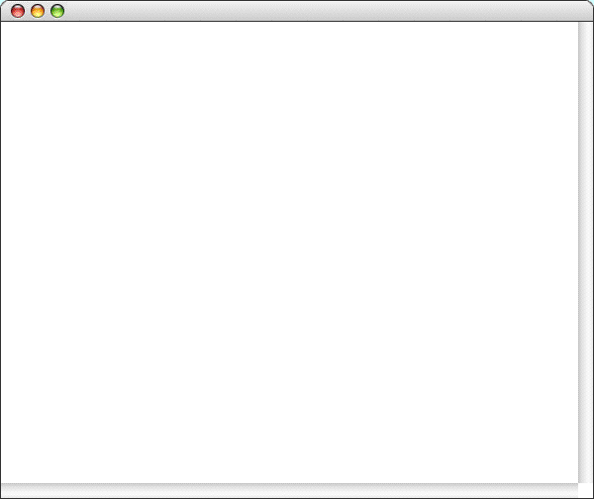
Symbol Table Sample Run
SymbolTableTest
>
pi = 3.14159
>
e = 2.71828
>
x = 2.00
>
pi
3.14159
>
x
2
>
list
e = 2.71828
pi = 3.14159
x = 2
>
x = 42
>
a = 1.5
>
list
a = 1.5
e = 2.71828
pi = 3.14159
x = 42
>
quit

Slide 18
The foreach Statement
One of the common operations that clients need to perform when using a collection is to iterate through the elements.
While it is easy to implement iteration for vectors and grids using for loops, it is less clear how you would do the same for other collection types. The modern approach to solving this problem is to use a general tool called an iterator that delivers the elements of the collection, one at a time.
C++11 uses a range-based for statement to simplify iterators:
for (string key : map) {
. . . code to process that key . . .
}
The Stanford libraries implement the same idea like this:
foreach (string key in map) {
. . . code to process that key . . .
}

Slide 19
Methods in the Set<type> Class
set.size()
Returns the number of elements in the set.
set.isEmpty()
Returns true if the set is empty.
set.add(value)
Adds value to the set.
set.remove(value)
Removes value from the set.
set.contains(value)
Returns true if the set contains the specified value.
set.clear()
Removes all words from the set.
s1.isSubsetOf(s2)
Returns true if s1 is a subset of s2.
set.first()
Returns the first element of the set in the ordering specified by the value type.

Slide 20
Methods in the Lexicon Class
lexicon.size()
Returns the number of words in the lexicon.
lexicon.isEmpty()
Returns true if the lexicon is empty.
lexicon.add(word)
Adds word to the lexicon, always in lowercase.
lexicon.addWordsFromFile(filename)
Adds all the words in the specified file to the lexicon.
lexicon.contains(word)
Returns true if the lexicon contains the specified word.
lexicon.containsPrefix(prefix)
Returns true if the lexicon contains any word beginning with prefix.
lexicon.clear()
Removes all words from the lexicon.

Slide 21

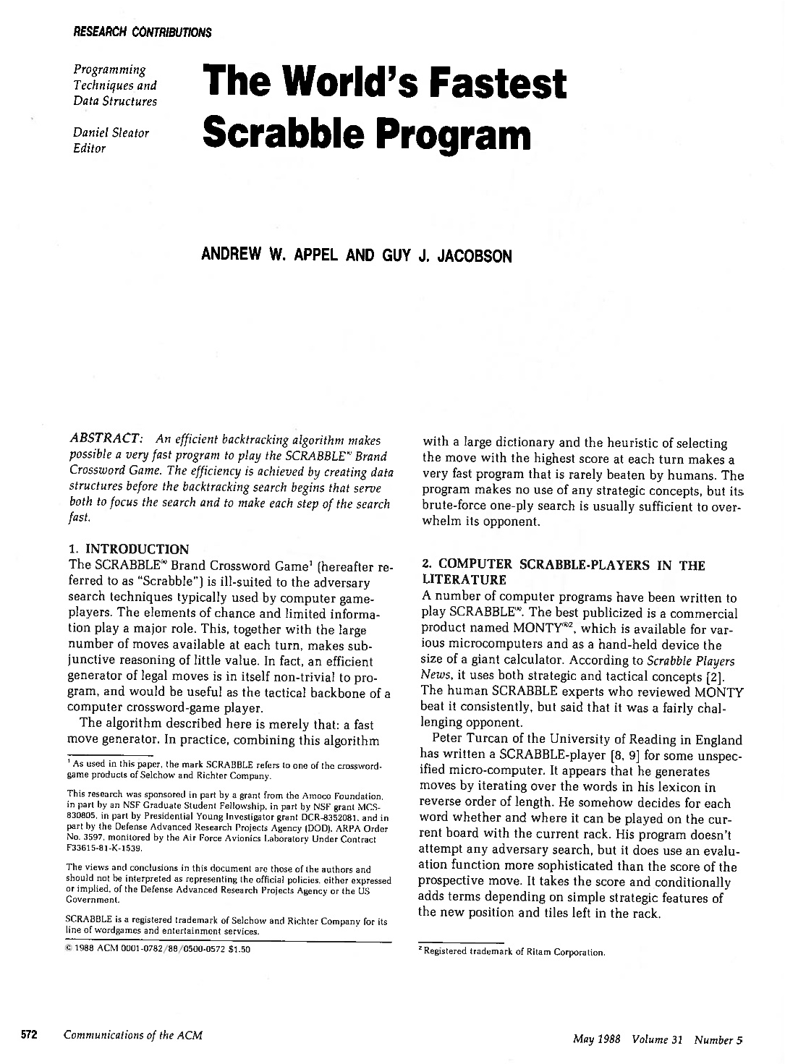
Why Do Both Lexicon and Set Exist?
The Lexicon representation is extremely space-efficient. The data structure used in the library implementation stores the full English dictionary in 350,000 bytes, which is shorter than a text file containing those words.
The underlying representation makes it possible to implement a containsPrefix method that is useful in many applications.
The representation makes it easy for iterators to process the words in alphabetical order.

Slide 22
Iterator Order
When you look at the documentation for an iterator, one of the important things to determine is whether the collection class specifies the order in which elements are generated. The Stanford C++ libraries make the following guarantees:
Iterators for arrays operate in index order.
Iterators for grids operate in row-major order, which means that the iterator runs through every element in row 0, then every element in row 1, and so on.
Iterators for the Map class deliver the keys in the order imposed by the standard comparison function for the key type; iterators for the HashMap class return keys in a seemingly random order.
Iterators for the Set class deliver the elements in the order imposed by the standard comparison function for the value type; the HashSet class is unordered.
Iterators for lexicons always deliver words in alphabetical order.

Slide 23
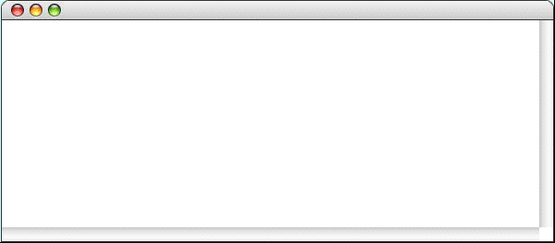
Exercise: Finding Anagrams
Write a program that reads in a set of letters and sees whether any anagrams of that set of letters are themselves words:
FindAnagrams
Enter tiles:
ehprsyz
zephyrs
Enter tiles:
aeinstr
anestri
nastier
ratines
retains
retinas
retsina
stainer
stearin
Generating all anagrams of a word is not a simple task. Most solutions require some tricky recursion, but can you think of another way to solve this problem? Hint: What if you had a function that sorts the letters in a word. Would that help?
Generating all anagrams of a word is not a simple task. Most solutions require some tricky recursion, but can you think of another way to solve this problem? Hint: What if you had a function that sorts the letters in a word. Would that help?

Slide 24

Exercise: Finding “S” Hooks
In Scrabble, one of the most important strategic principles is to conserve your S tiles so that you can hook longer words (ideally, the high-scoring seven-letter plays called bingos) onto existing words.
Some years ago, I was in a hotel where the shower taps were prominently labeled with HOT and COLD:
Being a Scrabble player, it happened to occur to me that each of these words takes an S on either end, making them ideally flexible for Scrabble plays.
Write a C++ program that finds all such words.

Slide 25
The End

